Slide 1
Database Specifications Final Project
By Marilyn Flowers, Maksym Melnyk, Won Geun Oh, and Ayobami Adebowale

Slide 2
AGENDA
Introduction
General Information
Database Identification and Description
Database Administrative Information

Slide 3
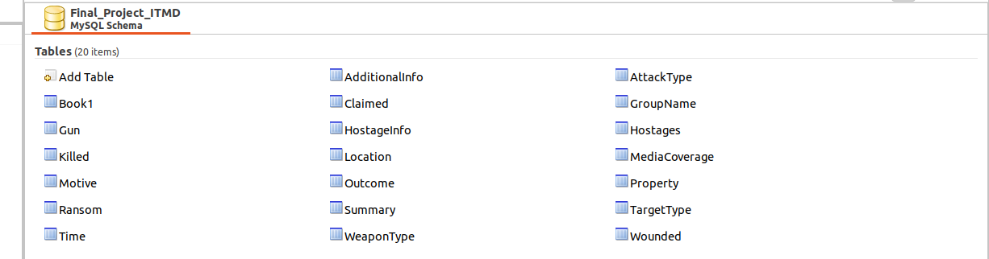
General Information
Our Database

Slide 4
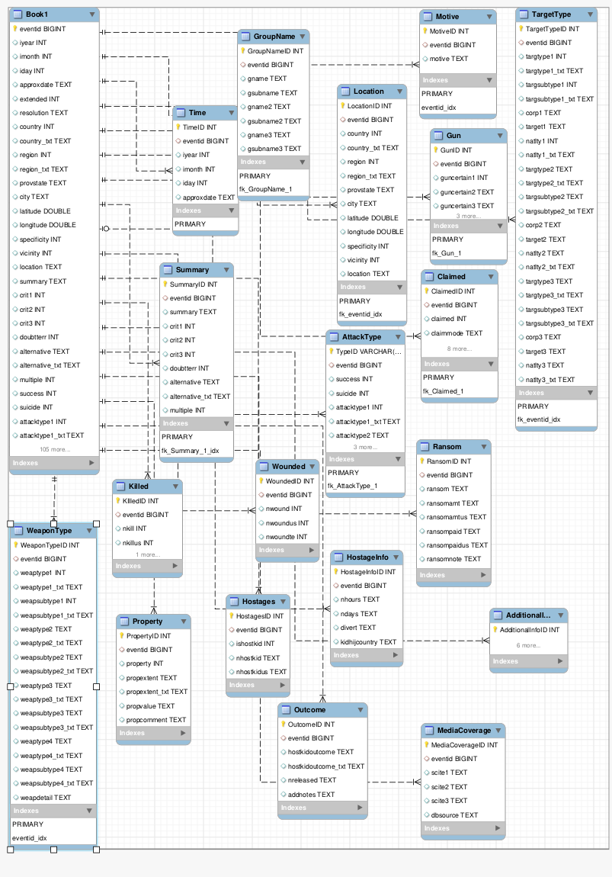
General Information Part Two
Our EER Diagram

Slide 5
Database Identification and Description
Our database is one of the many databases containing information on the general concept of crime. As seen in earlier slides, this database specifically analyzes the certain aspects of crime such as gun type, murder charge, and motive.

Slide 6
DATABASE ADMINISTRATIVE INFORMATION (Maksym Melnyk)
Structure:
Responsibility
Identification of the organizations and personnel responsible for the following database administrative functions.
System Information
Database Management System (DBMS) Configuration
Hardware Configuration
Database Software Utilities
Support Software Available for Maintaining Database
Storage Requirements
Recovery
Partition/File Information
Notes:
This is the structure of the overall database administration

Slide 7
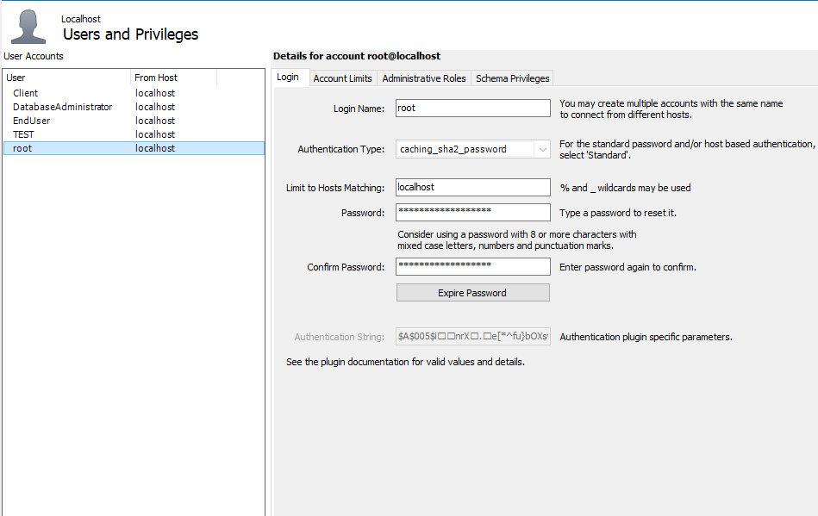
Responsibility
Database Administrator
System Administrator
Security Administrator
Distinct users: EndUser, Client, TEST and root
Notes:
The database system has several users with their own responsibilities
Database administrator:
Install and maintain the performance of database server.
Develop processes for optimizing database.
Set and maintain database standards.
Manage database access.
Performance tuning of database systems.
Install, upgrade, and manage database applications.
Diagnose and troubleshoot database errors.
System administrator:
Install and configure software and hardware.
Manage network servers and technology tools.
Set up accounts and workstations.
Monitor performance and maintain systems according to requirements.
Troubleshoot issues and outages.
Security administrator:
Create, drop, alter, and rename security label components
Create, drop, and rename security policies
Create, drop, and rename security labels

Slide 8
System Information
-Database Management System (DBMS) Configuration
Identified the vendor, version and targeted hardware for the DBMS. Integrated restrictions on the initialization and use of the DBMS to support any intended distributed processing.
‹#›
Notes:
A Database Management System is defined as the software system that allows users to define, create, maintain and control access to the database. A DBMS helps to define, create, manipulate and share the database among different users and applications In our case was used MySQL with version 8.0.22 For Ubuntu

Slide 9
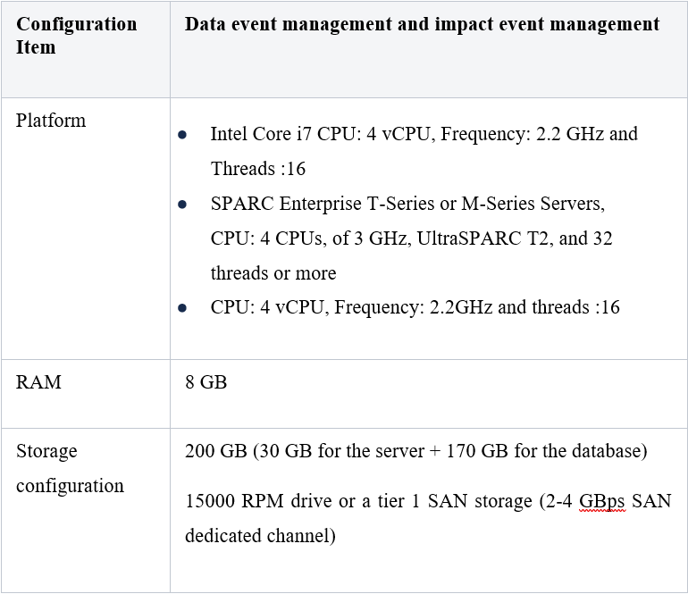
Hardware Configuration
Projected hardware for the project
‹#›
Notes:
There is no official minimum for the hardware requirements that are needed to host the Database server. The hardware specifications will change under the influence of different factors that should be taken into account.

Slide 10
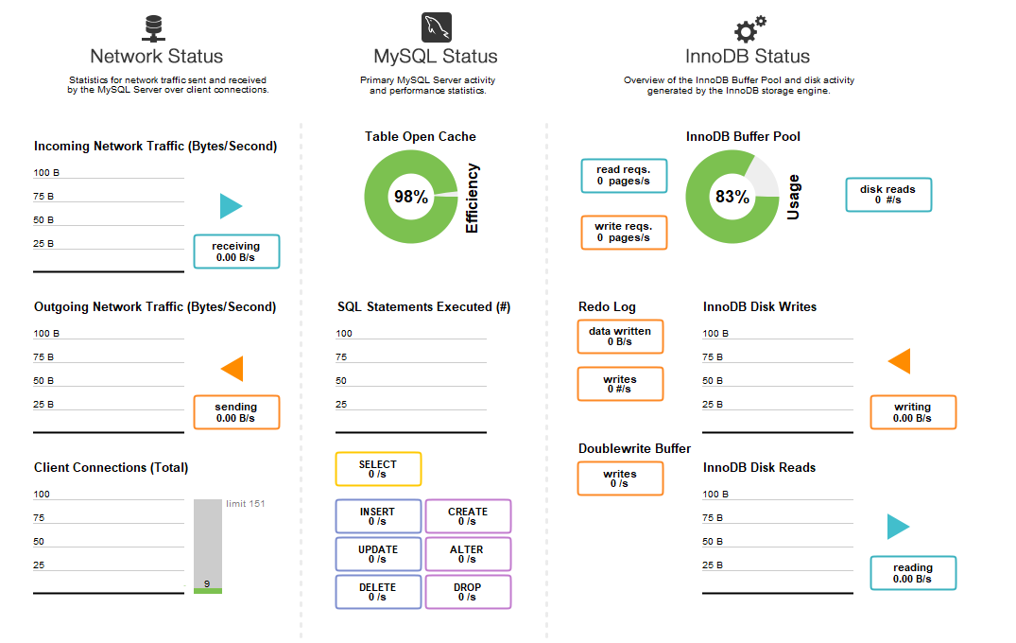
Database Software Utilities
MySQL Workbench dashboard overview utility
‹#›
Notes:
Database Software Utilities
DBMS software can include System profilers, Network Managers, Application Launchers, disk repair, file manager, file compression and data security. These all apply to the database as data was transferred into the database and managed to properly handle the opening of all test tables. These software utilities help to open the MySQL program, and allows for the programming of data. Although the efforts seem to be minimal, there are surfaces of development that are ignored. A consumer normally does not think about the efforts made and establish the level of necessity for all operations to run under simple utilities mentioned above. These all work together to keep the created database up to date and the software allows real time translation and projection.

Slide 11
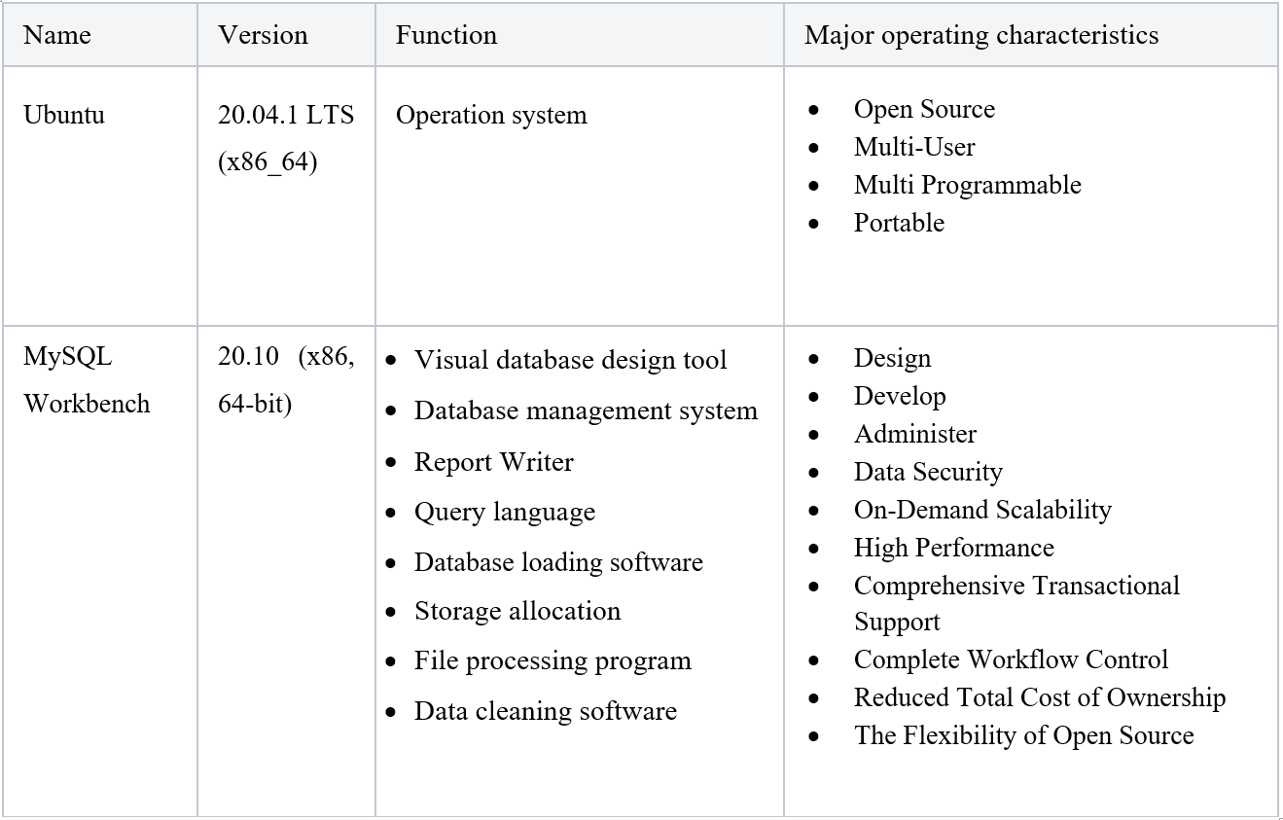
Support Software Available for
Maintaining Database
Described all support software, including the operating system, directly related to the database, including name, Version, function, and major operating characteristics.
‹#›
Notes:
Support software such as MySQL Workbench and many more are considered normal support software but for this project specifically, MySQL Workbench were considered essential as it was directly related to the database. Specified in more detail in database specifications file

Slide 12
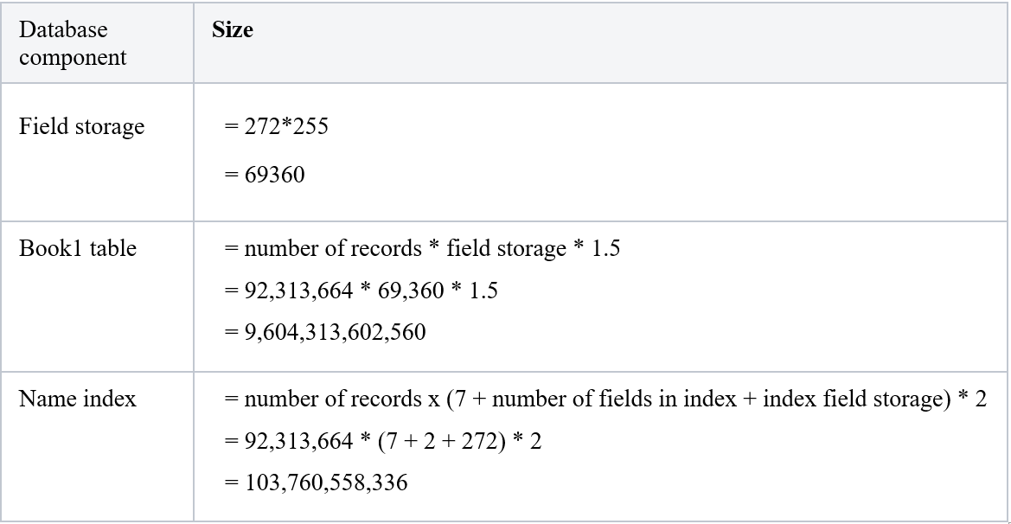
Storage Requirements
Approximate database size calculation
‹#›
Notes:
All the information in a database is organized and structured in database tables. These tables are stored on the hard disk of the database server. The database tables are divided into columns and rows, just like a regular graphic table. In a database table, the columns specify the information category and the data type, and the rows hold the actual information. This structure is chosen for its ease of use – it can be easily indexed, accessed or modified.
In our case we were able to count approximate number of bits used by the database giving us a general idea about size of data we are dealing with.

Slide 13
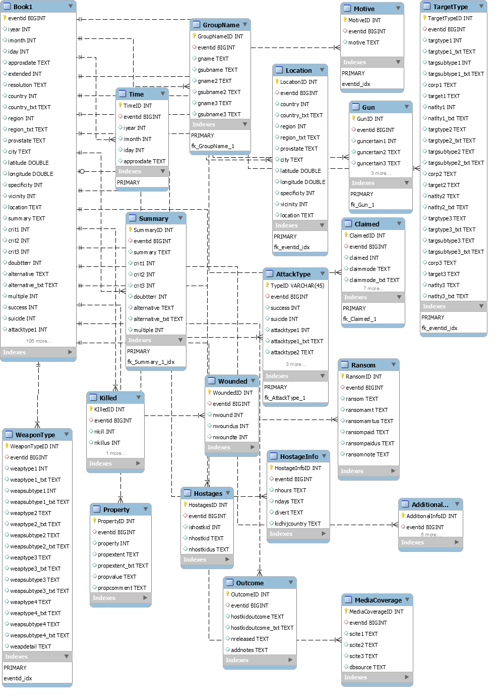
Partition/File Information
Described the content of each partition/file, listing the records it contains and explaining the purpose.
‹#›
Notes:
Partitioning is the database process where very large tables are divided into multiple smaller parts. By splitting a large table into smaller, individual tables, queries that access only a fraction of the data can run faster because there is less data to scan. The main goal of partitioning is to aid in maintenance of large tables and to reduce the overall response time to read and load data for particular SQL operations.

Slide 14
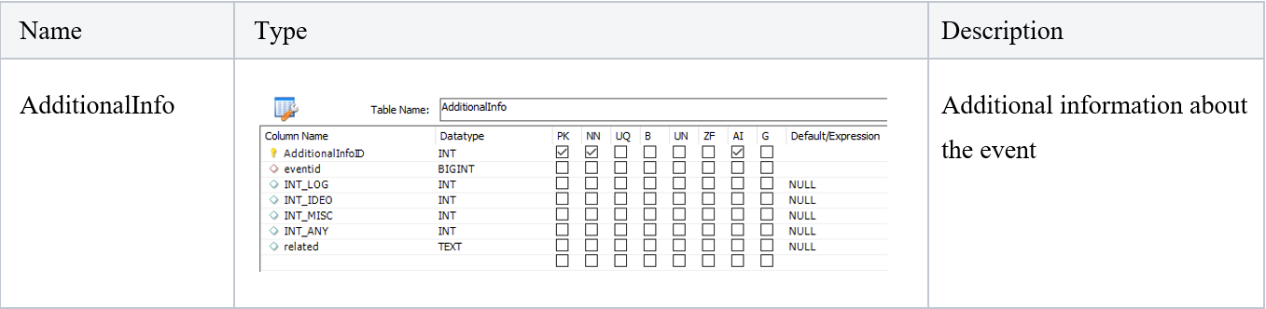
Description
Described the design and format of each table partition/file, including name, type, mapping, limitations, and mechanisms.
‹#›

Slide 15


